Slide 1

Lesson 4
Extended Entity Relationship Diagrams (EERD)
1

Slide 2
Session Outline
At the end of this lesson you will learn:
the limitations of the basic concepts of the ER model
enhanced Entity–Relationship (EER) model
additional data modeling concepts
super class/sub class
specialization/generalization
constraints in EER model
specialization hierarchy and lattice
union type or category

Slide 3
Extended Entity Relationship (EER)
Includes all modeling concepts of basic ER.
Additional concepts:
subclasses/ super classes
specialization/generalization
categories (UNION types)
attribute and relationship inheritance
EER includes some object-oriented concepts, such as inheritance.
EER model = ER model + hierarchical relationships.

Slide 4
Class Hierarchy
Superclass (Super type)
An entity type that includes one or more distinct subgroupings of its occurrences, which require to be represented in a data model.
Has distinct subclasses.
Subclass (Sub type)
A distinct subgrouping of occurrences of an entity type, which require to be represented in a data model.

Slide 5
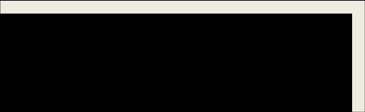
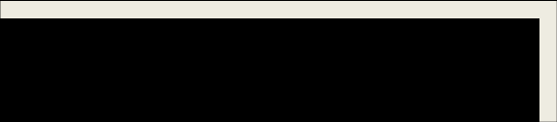
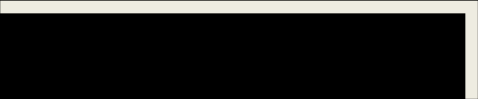


ISA Hierarchy
Attribute Inheritance in Super class / Sub class Relationships
Name
Employee
EmpNo
DOB
ISA
Exp_date
Hourly_Emp
Monthly_Emp
rate
No_of_hrs
Contract_no

Slide 6
Superclass /Subclass Relationships
The relationship between a superclass and any one of its subclasses.
Often referred to as an “IS-A” relationship.
Each member of a subclass is also a member of the superclass.
The entity in the subclass is the same entity in the superclass, but has a distinct role.
Sub class inherits all the attributes and relationship types of the super class.

Slide 7
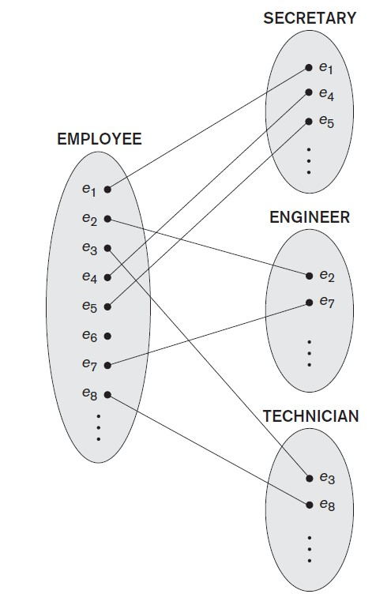
Superclass /Subclass Relationships

Slide 8
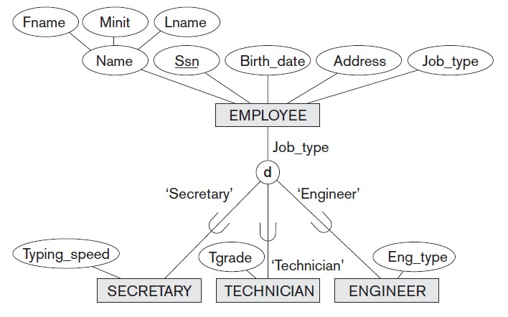

Slide 9
Specialization
The process of maximizing the differences between members of an entity by identifying their distinguishing characteristics.
A top-down approach to defining a set of super classes and their related subclasses.
The set of subclasses is defined on the basis of some distinguishing characteristics of the entities in the superclass.

Slide 10
Generalization
The process of minimizing the differences between entities by identifying their common characteristics.
A bottom-up approach, which results in the identification of a generalized superclass from the original entity types.
Identify the common features (attributes and relationships) of the sub classes and generalize them into a superclass.

Slide 11
EER Diagrams
Subclasses that define a specialization are attached by lines to a circle, which is connected with the super class.
Subset symbol indicates direction of the relationship (towards the super class).
Specific attributes (those that apply only to the entities of the subclass) are attached to that subclass.

Slide 12
Constraints on Subclasses
Can determine exactly the entities that will become members of each sub classes.
Predicate-defined subclasses
Attribute-defined subclasses

Slide 13
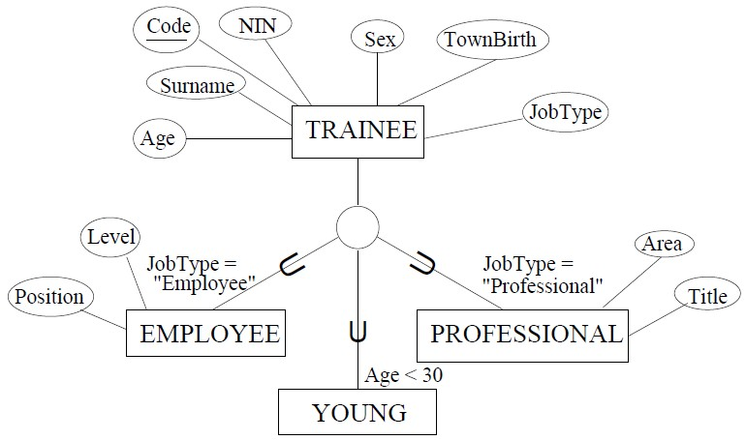
Predicate-defined subclasses
Based on a predicate (establish) condition which act as constraints on the members of subclasses.

Slide 14
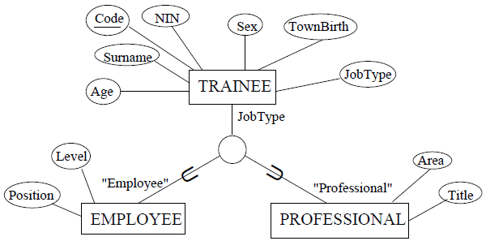
Attribute-defined subclasses
If all subclasses in a specialization have the membership condition on the same attribute of the super class.

Slide 15
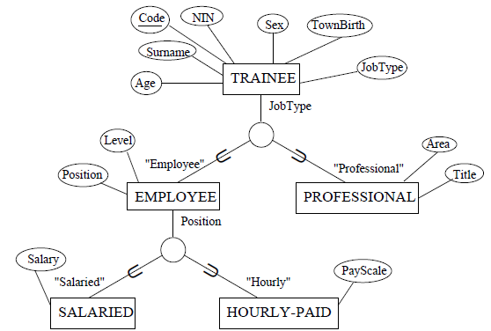

Slide 16
Disjoint Constraint
Describes the relationship between members of the subclasses and indicates whether it is possible for a member of a superclass to be a member of one, or more than one, subclass.
There are two types of constraints:
‒ Disjoint
‒ Overlap

Slide 17
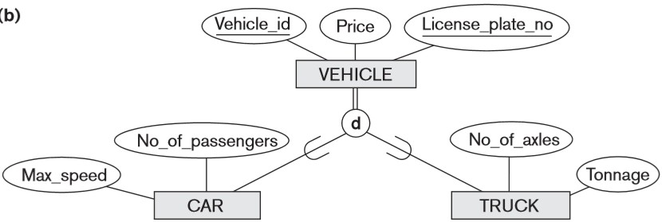
Disjoint
An entity occurrence can be a member of only one subclass of the specialization
The disjoint constraint only applies when a superclass has more than one subclass.

Slide 18
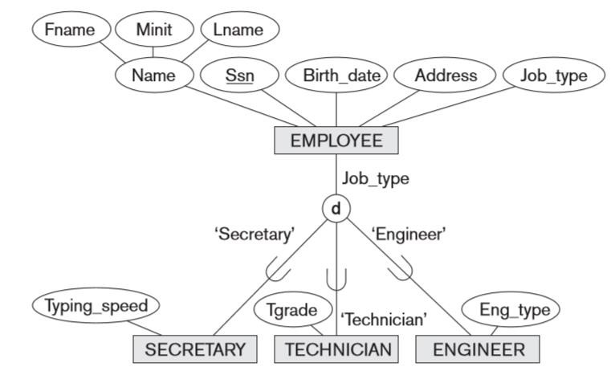
Disjoint

Slide 19
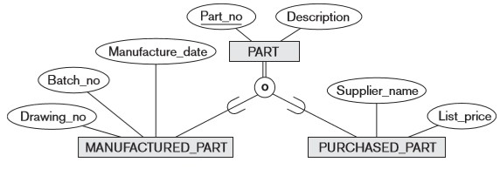
Overlap
An entity occurrence may be a member of more than one subclass.

Slide 20
Participation Constraints
Determines whether every member in the superclass must participate as a member of a subclass.
Total Specialization
every entity in a super class must be a member of some subclass in some specialization.
Partial Specialization
allows an entity of a superclass need not belong to any of its subclasses.

Slide 21
Four types of Specializations
Disjoint, Total
Disjoint, Partial
Overlapping, Total
Overlapping, Partial

Slide 22
Specialization Hierarchy & Lattice
Specialization Hierarchy
Every subclass participates as a subclass in only one class/subclass relationship.
Each subclass has only one parent.
Single inheritance
Specialization Lattice
A subclass can be a subclass in more than one class/subclass relationship.
A subclass with more than one superclass is called a ‘shared
subclass’.
Multiple inheritance

Slide 23
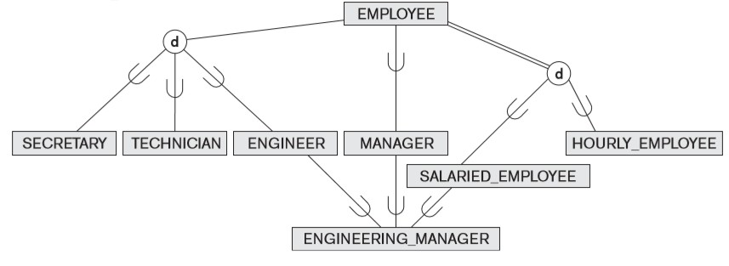
Specialization Lattice

Slide 24
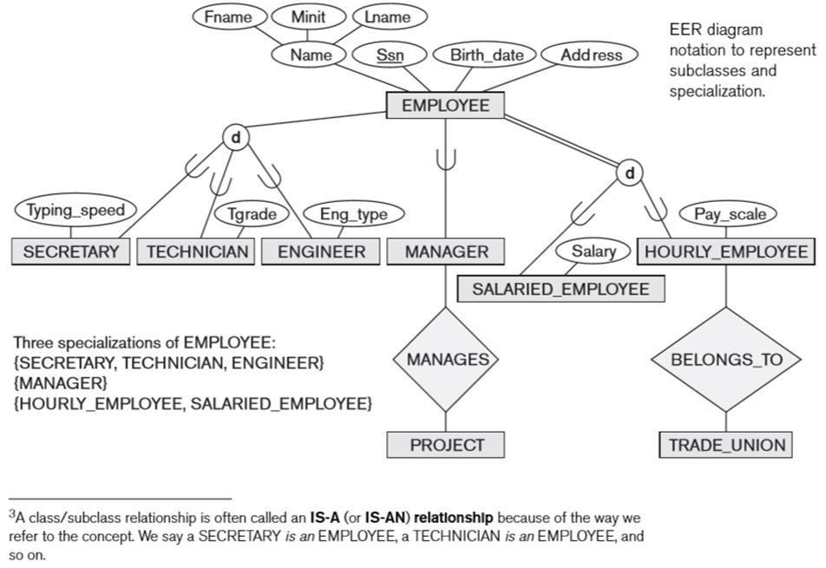

Slide 25
Specialization Lattice
ENGINEERING_MANAGER is a subclass of each of the three
super classes ENGINEER, MANAGER, and SALARIED_EMPLOYEE.
An entity that is a member of ENGINEERING_MANAGER must exist in all three.
ENGINEERING_MANAGER inherits all the attributes of its super classes.
If an attribute (or relationship) originating in the same superclass is inherited more than once via different paths in the lattice, then it should be included only once in the shared subclass.

Slide 26
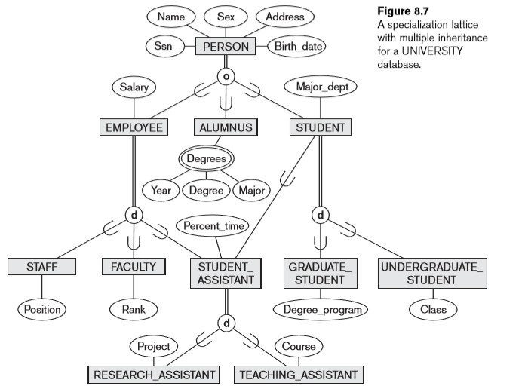

Slide 27
UNION Type / Category
A single subclass (superclass/subclass relationship) with more than one superclass.
Has two or more super classes that may represent different entity types.
Subclass will represent a collection of objects that is a subset of the UNION of distinct entity types (its super classes).
Attribute inheritance works more selectively in the case of categories.

Slide 28
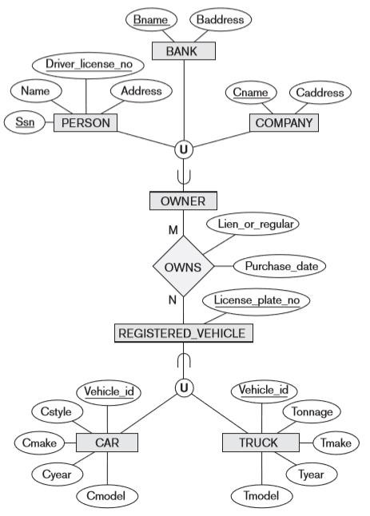
UNION Type
/ Category

Slide 29
UNION Type / Category
OWNER:
A subclass of the UNION of the three entity sets of COMPANY, BANK and PERSON.
An entity that is a member of OWNER must exist in only one of the super classes.
An OWNER of a vehicle can be a PERSON, or a BANK, or a COMPANY.
Each OWNER entity inherits the attributes of a COMPANY or a PERSON or a BANK, depending on the superclass to which the entity belongs.

Slide 30
UNION Type / Category
REGISTERED_VEHICLE:
A subclass of the union of CAR and TRUCK.
REGISTERED_VEHICLE category includes some cars and some trucks but not necessarily all of them.
Some cars or trucks may not be registered.
Implies that only cars and trucks, but not other types of entities, can be members of REGISTERED_VEHICLE.

Slide 31
Participation Constraint
A category can be total or partial.
A total category holds the union of all entities in its super classes, whereas a partial category can hold a subset of the union.
A total category is represented diagrammatically by a double line connecting the category and the circle, whereas a partial category is indicated by a single line.
Eg:
OWNER: Total
REGISTERED_VEHICLE: Partical

Slide 32
Key attributes
The super classes of a category may have
different key attributes, as demonstrated by the OWNER category
or
same key attribute, as demonstrated by the REGISTERED_VEHICLE category.
It may be represented alternatively as appropriate.

Slide 33
Thank You
33

